Slide 1


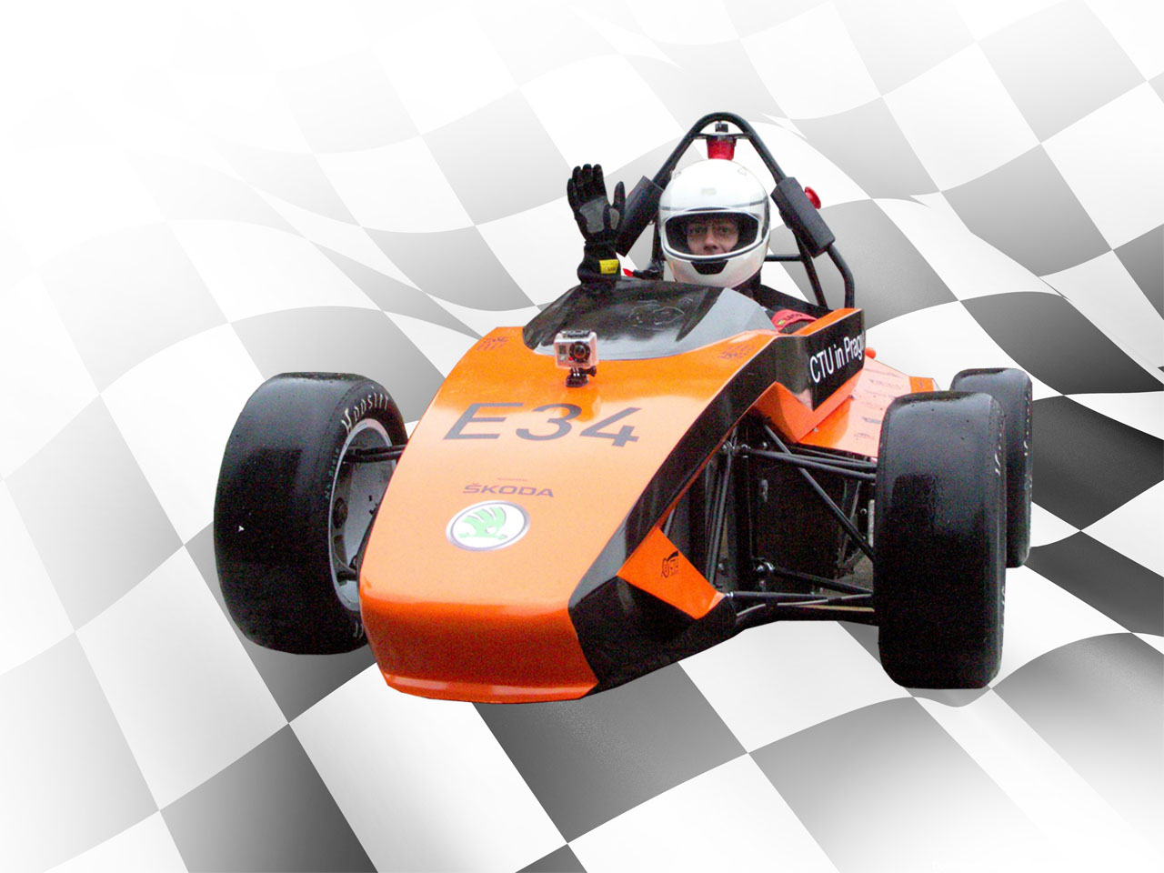
FORMULA STUDENT/SAE TEAM
Business plan presentation
Czech Technical University Formula Student/ SAE Team www.cartech.cvut.cz

Slide 2

content
Introduction
Business strategy
4P
Investition
Summary
Czech Technical University Formula Student/ SAE Team www.cartech.cvut.cz

Slide 3
Introduction
1.1 – Introduction of formula
1.2 – Who are we?
1.3 – Our customers
Czech Technical University Formula Student/ SAE Team www.cartech.cvut.cz

Slide 4
Business strategy
2.1 – How to get customers?
2.2 – Market places
2.3 – After sale services
Czech Technical University Formula Student/ SAE Team www.cartech.cvut.cz

Slide 5
4P
3.1 – Product
3.2 – Place
3.3 – Promo
3.4 - Price
Czech Technical University Formula Student/ SAE Team www.cartech.cvut.cz

Slide 6
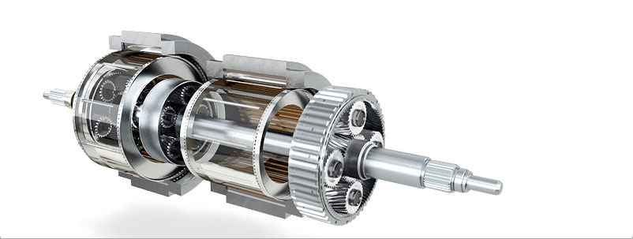
4P - Product
120 km/h
66 kW
315 kg
4,7 s.
customization
Czech Technical University Formula Student/ SAE Team www.cartech.cvut.cz

Slide 7


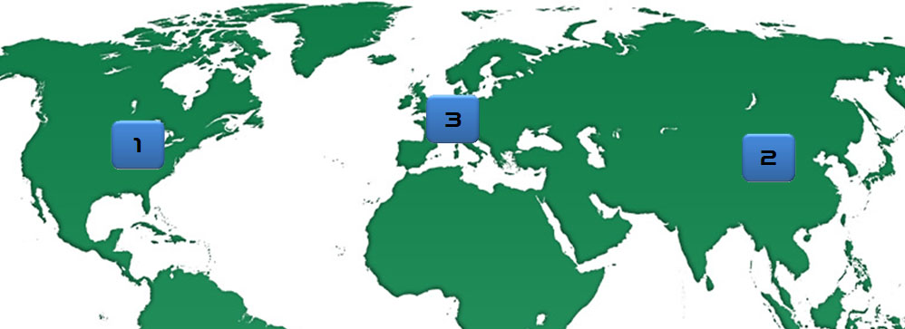
4P - Place
Czech Technical University Formula Student/ SAE Team www.cartech.cvut.cz

Slide 8




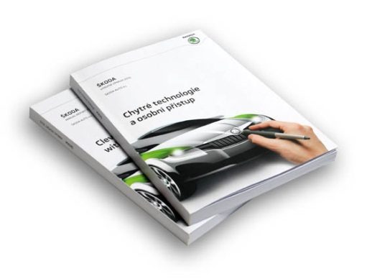
4P - Promo
Czech Technical University Formula Student/ SAE Team www.cartech.cvut.cz

Slide 9
4P - Price
Prototype price – 31.000 $
Price of the basic model – > 25.000$
Price of the top model – 37.000$
Commision – 20 %
Czech Technical University Formula Student/ SAE Team www.cartech.cvut.cz

Slide 10
Investment
Czech Technical University Formula Student/ SAE Team www.cartech.cvut.cz

Slide 11
summary
Production model
Model of sales .
Investment model
Thank you for your attention.
Czech Technical University Formula Student/ SAE Team www.cartech.cvut.cz

